Slide 1

Amazon
Data-cated
Eirik Fosnaes
Jillian Pflugrath
Nancy Jain
Yifan Xiang
Ziyu Jin

Slide 2

Agenda
Assumptions and Data Preparation
Data Analysis
Variable Selection
Clustering Method and results
Classification Method and results
Business Insights and Recommendations

Slide 3
Assumptions and Data Preparation
Removed nulls and Geo_Unclaimed
Replaced null Product_id with 0
Age : (Registered Date - Billing Month)
Created a new table with product count, billing amount, tools, tools_yes_no, month, customer id, geo_code, size

Slide 4
Data Analysis

Slide 5
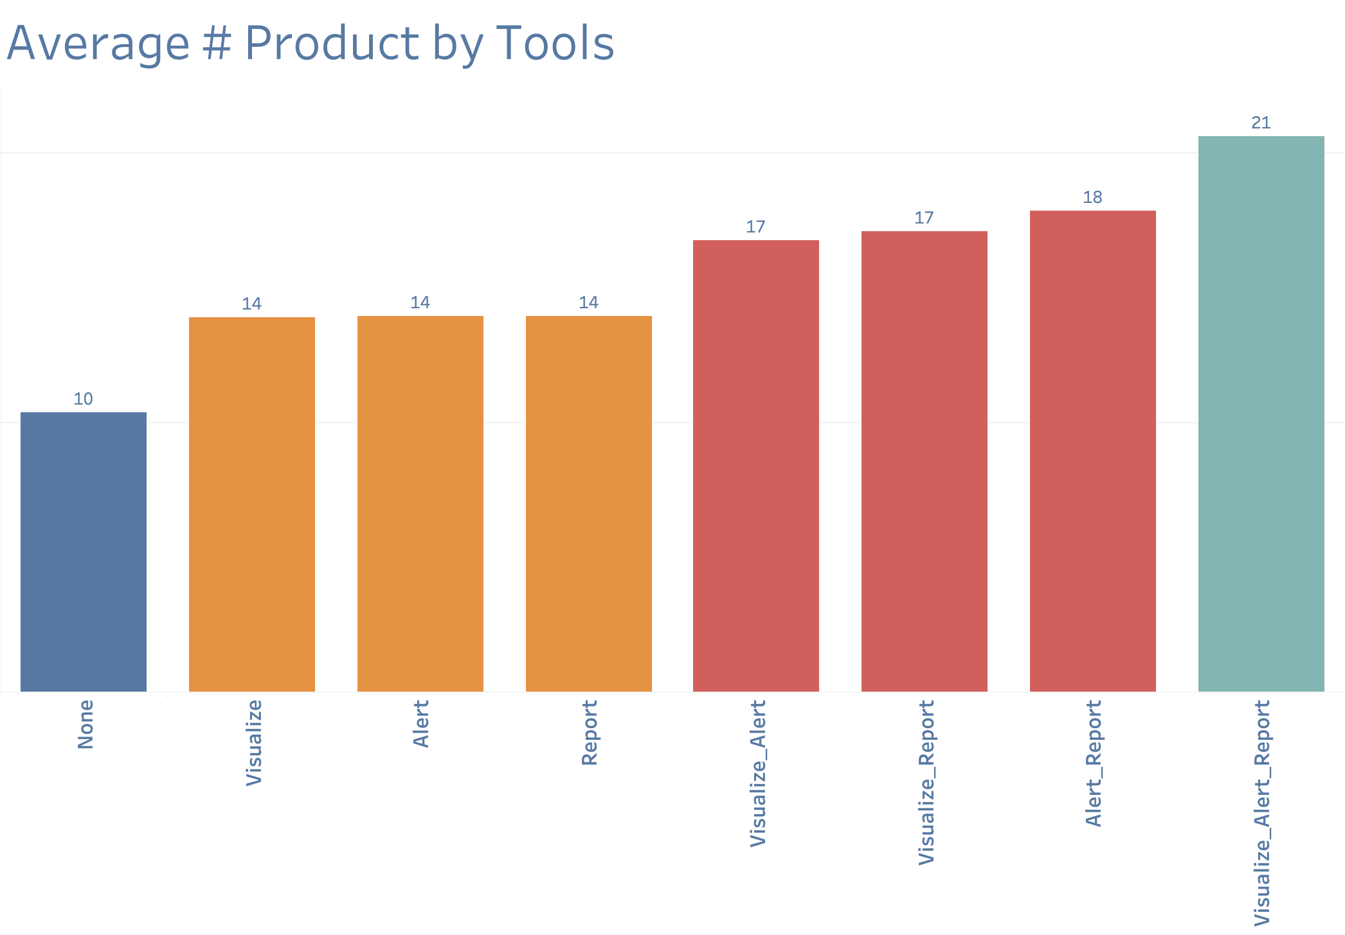
The more products customers buy, the more tools they use.
Notes:
There are eight different options for the customer when it come to using the tools
Those eight options belong to four basic groupings
No tools - blue
1 tool - orange
Different combos of 2 tools – red
All three tools - turquoise
When analyzing the average number of products used those four basic groupings are clearly identifiable

Slide 6
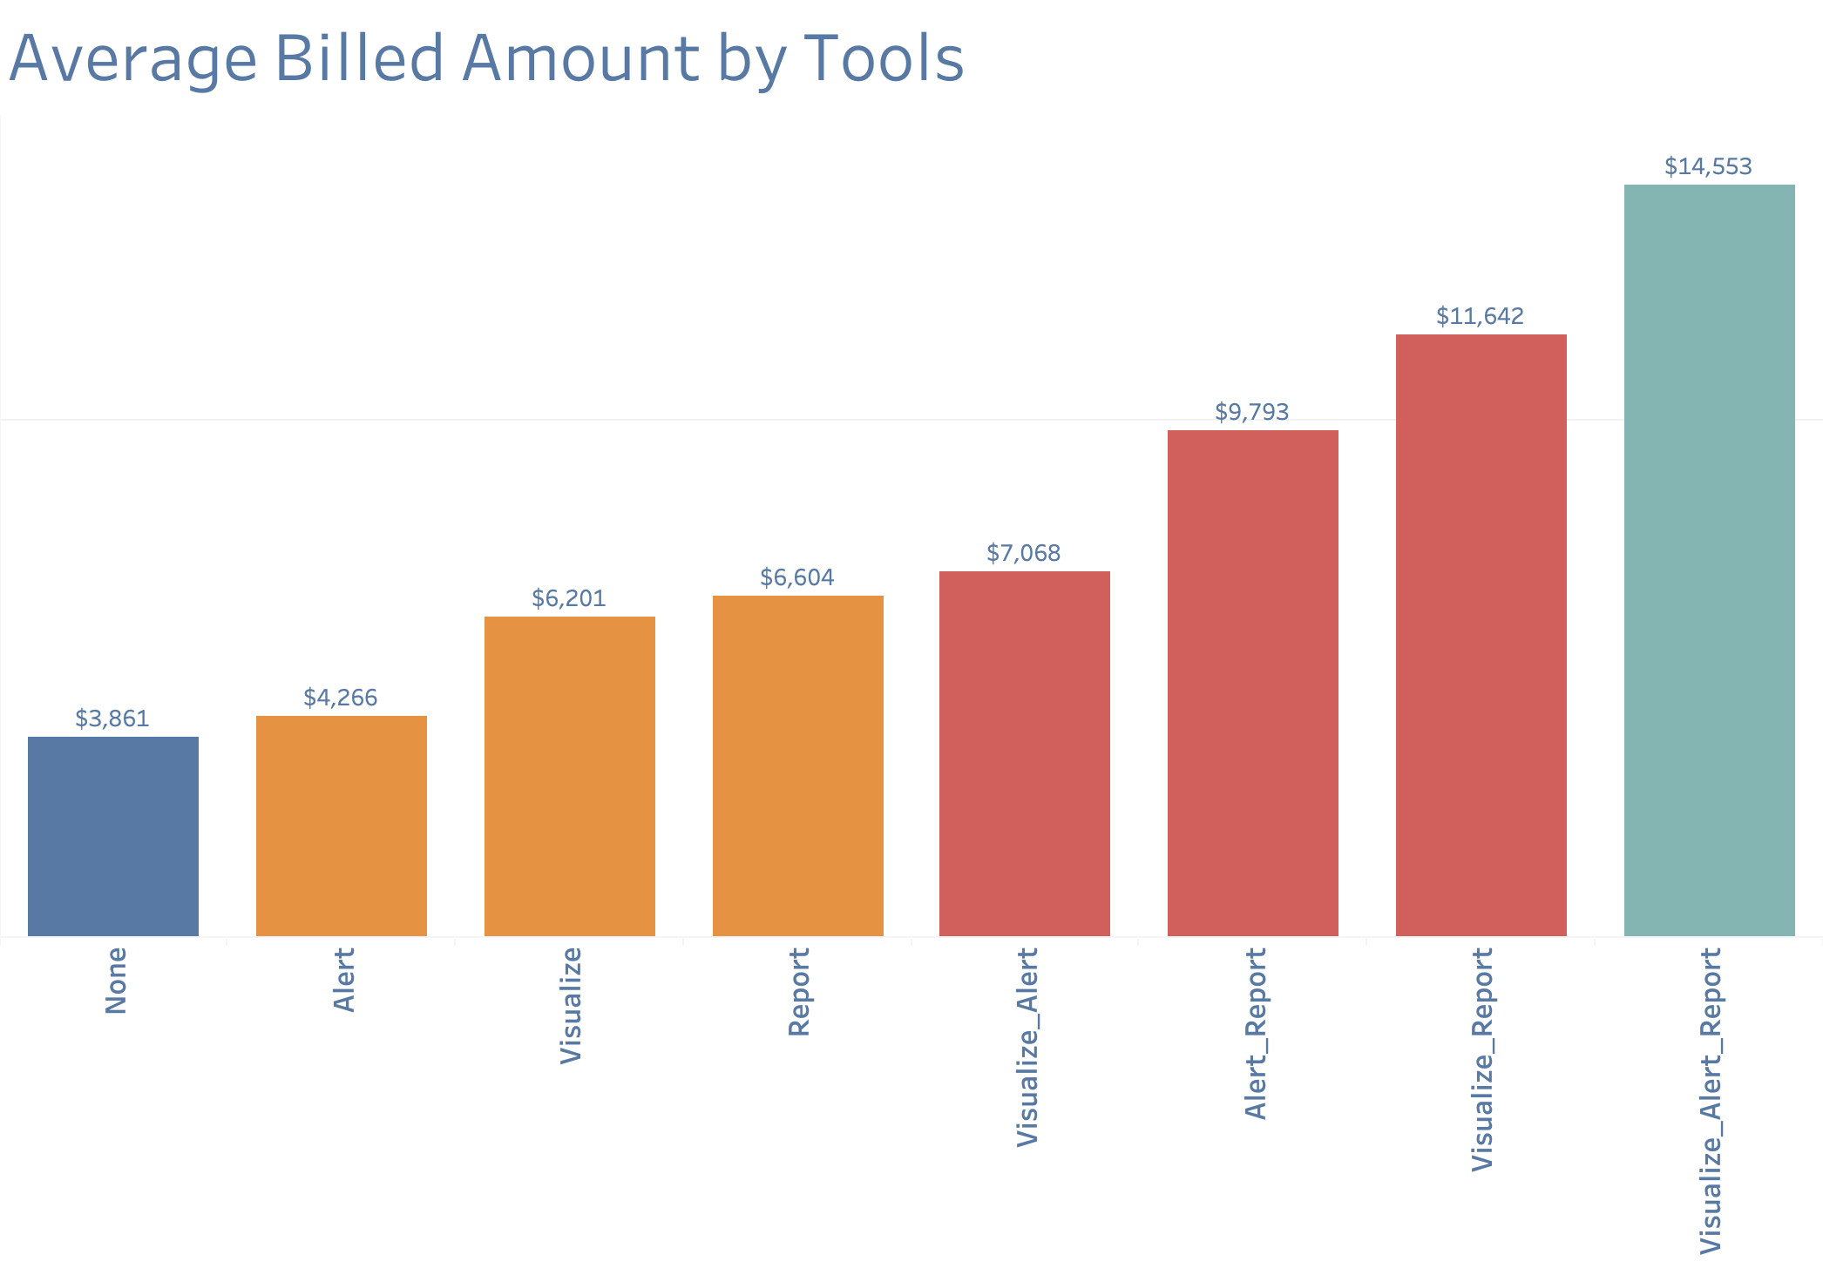
The more customers are billed, the more tools they use.
Notes:
Same groupings here but analyzing the average monthly billed amount
Also clear

Slide 7
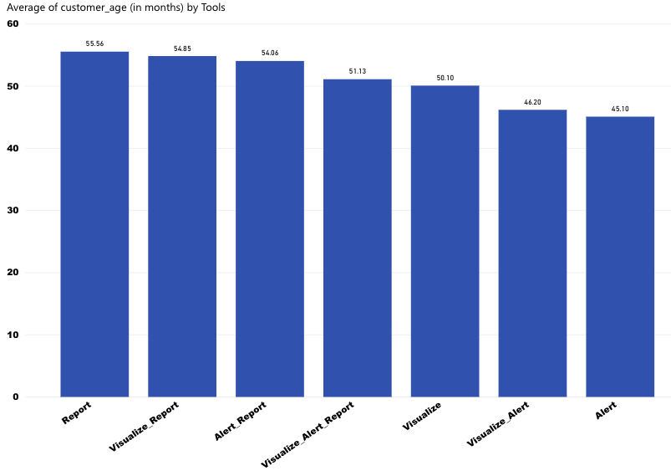
Average Age(in months) by Tools

Slide 8
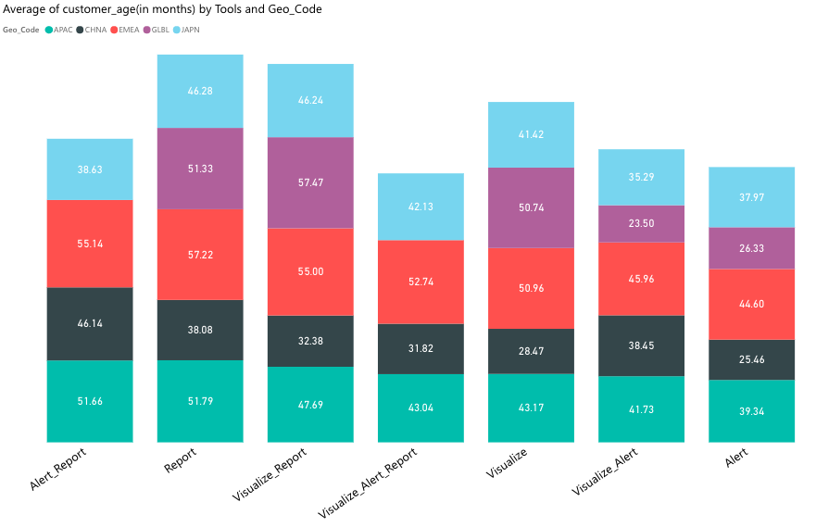
Average Age(in months) by Tools and Geo_code

Slide 9
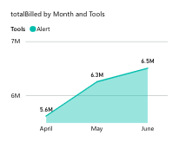
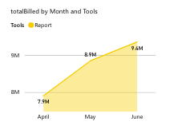
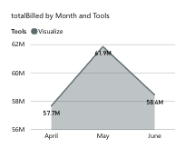
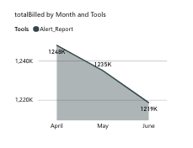
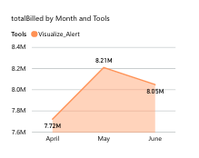
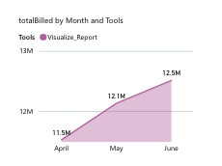
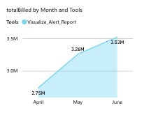
Trend in tools usage

Slide 10
Variable Selection
Independent Variables
Customer age
Total billed
Customer size – Small, Mid, Large
Number of Products Used
Geo code
Dependent Variables
Tools yes/ no: Implies if Report, Visualize, Alert is used or not
Tools: Implies which tool(Report, Visualize, Alert) is used
Clusters

Slide 11
Clustering Model
Number of clusters: 5
Clustering Method: K-Means

Slide 12
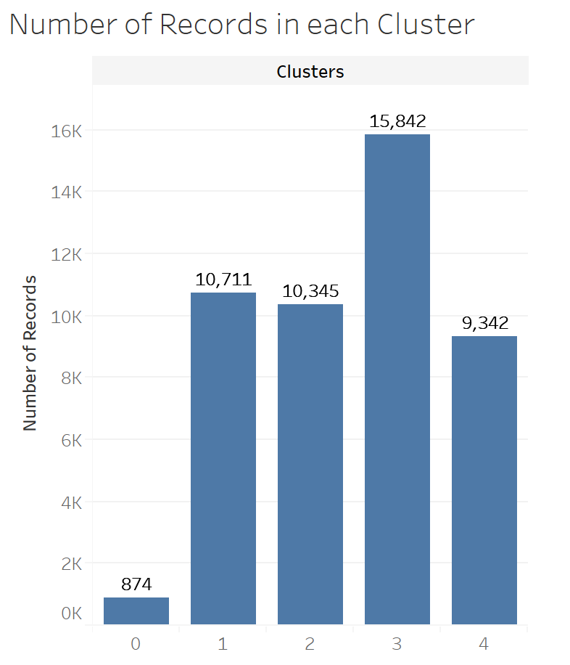
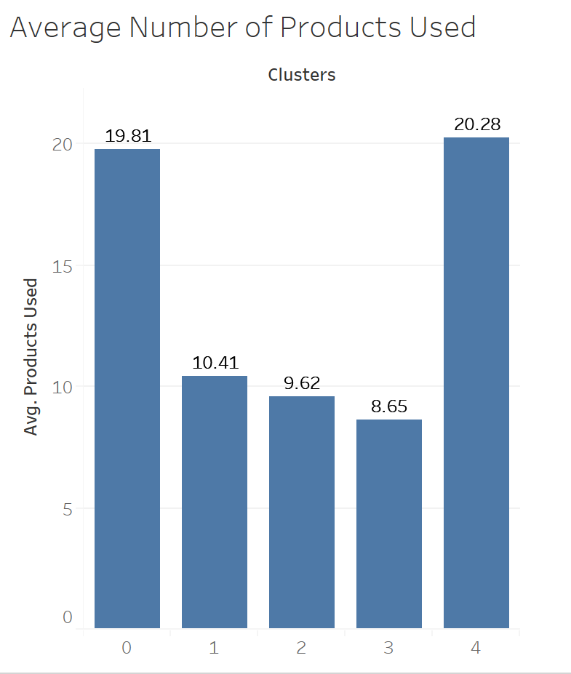
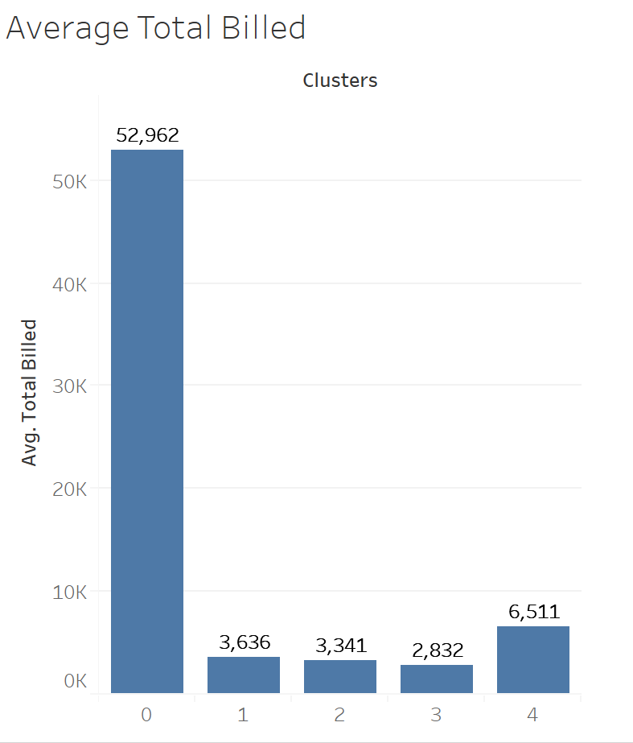
Cluster Analysis
Geographical area in clusters:
Cluster 3 – EMEA & AMER
Cluster 2 – Remaining 4 Geo Codes

Slide 13
Prediction Model
Neural Network – use tools
Logistic Model – use Visualize
Decision Tree – use Alert
Decision Tree – use Report

Slide 14
Classification Models and results – Tools (Yes/ No)
 | Predicted - No | Predicted - Yes
Actual - No | 24060 | 8287​
Actual - Yes | 7201 | 7566
Model Name | Accuracy | Precision | Recall | F1 score
Neural Network | 67.13% | 47.73% | 51.24% | 49.42%

Slide 15
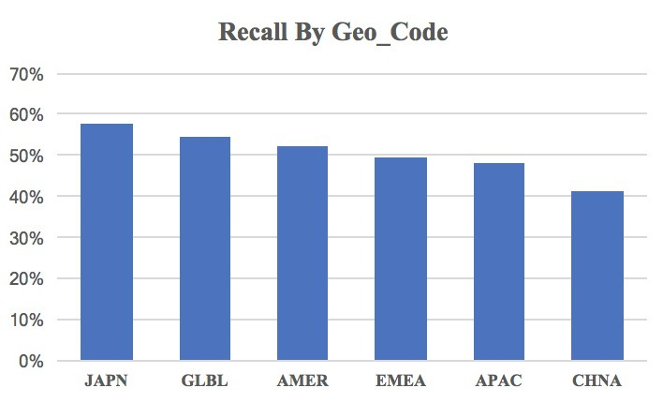
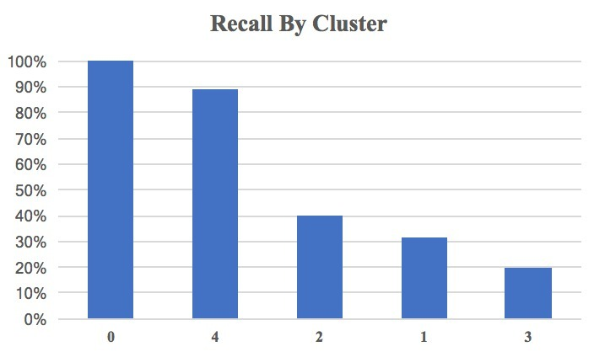
Findings
Important Variables:
Number of Products
Total Billed

Slide 16
Tool Prediction Models -Visualize
Tool | Model Name | Accuracy | Precision | Recall | F1 score
Visualize | Logit model | 80.79% | 80.79% | 100% | 89.38%
 | Predicted - No | Predicted - Yes
Actual - No | 0 | 2563
Actual - Yes | 0 | 10784

Slide 17
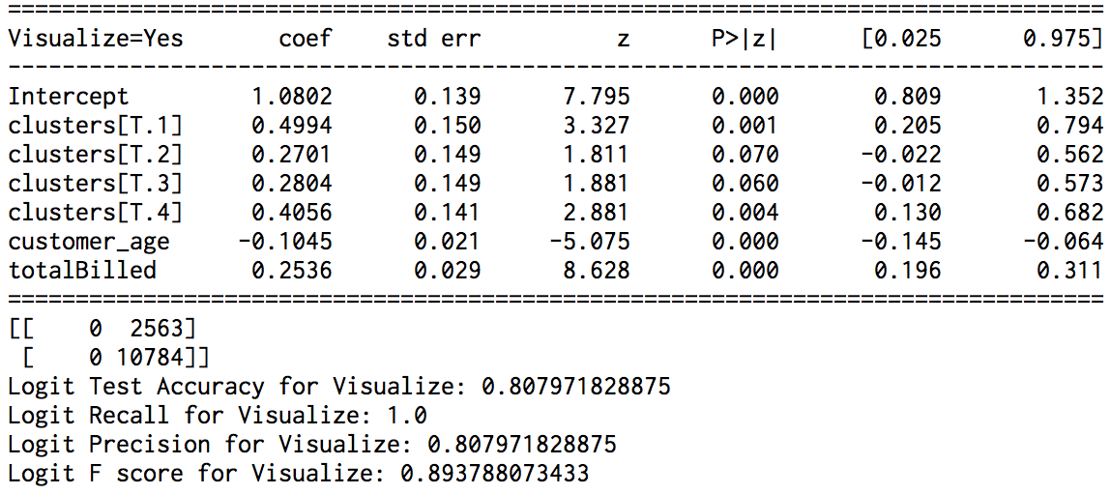
Findings
1. Everything else held fixed, increasing in total billed amount is associated with higher probability of using Visualize tool, while increasing in customer age is associated with lower probability of using Visualize tool.
2. Geographic location is not an important factor. (statistically insignificant)

Slide 18
Tool Prediction Models -Alert
Tool | Model Name | Accuracy | Precision | Recall | F1 score
Alert | Decision Tree | 74.2% | 29.47% | 23.27% | 26.00%
 | Predicted - No | Predicted - Yes
Actual - No | 9299 | 1448
Actual - Yes | 1995 | 605

Slide 19
Tool Prediction Models -Report
Tool | Model Name | Accuracy | Precision | Recall | F1 score
Report | Decision Tree | 76.27% | 29.81% | 23.36% | 26.19%
 | Predicted - No | Predicted - Yes
Actual - No | 9618 | 1323
Actual - Yes | 1844 | 562

Slide 20
Business Insights & Summary

Slide 21
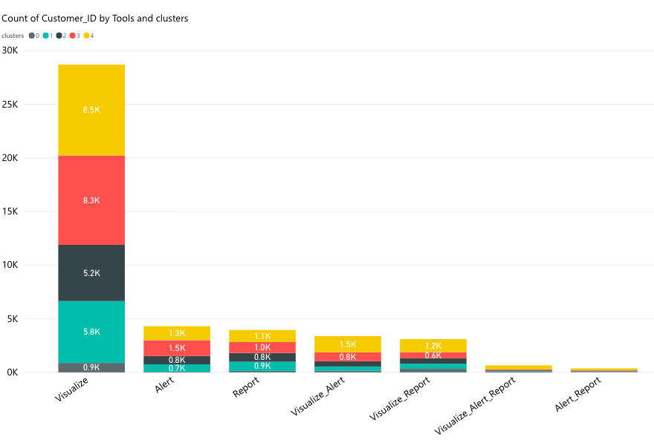
Business Insights
Among all records (April – May, date&customer ID as PK): 32% of records use tools, among those records with tools used, 81% use visualize tool, 19% use alert tool, 17.6% use report tool. ​
Recommendation:
Increase the usage of Visualize tool.
Figure out why the usage of Alert and Report is decreasing.
Target different age of customers in different geo area.
Target customers with large billed amount.
Target customers in cluster 4.
Need to have new marketing strategy to customers in cluster 1 and 2.
Notes:
Cluster 1: customer age 91 month average
Cluster 2: geo distribution

Slide 22
Questions ?

Slide 23
Appendix
Data Analysis dashboard
Cluster Analysis Dashboard

